Slide 1

FINAL CAPSTONE PROJECT PRESENTATION
Title: Predicting Student Performance Using Socioeconomic and Academic Data
Names: Uwitonze Pacific Course code & name: INSY 8413 & Introduction to Big Data Analytics Instructor: Eric Maniraguha
Academic Year: 2024–2025

Slide 2
Introduction
Many students struggle academically, and the reasons are often beyond the classroom like family support, study habits, or even alcohol use. This project uses real data to explore and predict which students are likely to pass or fail, using Big Data Analytics.

Slide 3
Problem Statement
Around the world, education systems try to help students succeed, but not all challenges are visible. Some students face personal or social issues that affect their grades. Schools need tools to detect these risks early.
In this project, I analyzed a dataset about students’ backgrounds, behaviors, and performance. My goal was to find patterns that affect final grades, and to predict student success using machine learning.
The main question I asked was: Can we predict a student's performance using social, academic, and personal factors? I also wanted to create insights that educators can use to make better decisions.

Slide 4
Dataset Overview
I used a dataset from the UCI Machine Learning Repository. -It combines data from math and Portuguese classes 382 students and 33 columns. -It includes information like gender, age, family support, alcohol use, and grades.

Slide 5
Data Cleaning & Preparation
-I merged and cleaned the dataset. -I encoded text columns into numbers, like ‘yes’ and ‘no’ into 1 and 0. -I created a new column called There were no major missing values.

Slide 6
Exploratory Data Analysis (EDA)
-I analyzed the data using Python. -I found that students who had more study time and family support were more likely to pass. -Alcohol use and repeated failures had negative effects. -I visualized this with histograms and heatmaps.

Slide 7
Modeling (Python)
I trained a Random Forest Classifier to predict whether a student would pass. I used features like study time, failures, absences, and alcohol use. The model achieved around 80% accuracy, and results were evaluated using a confusion matrix.

Slide 8
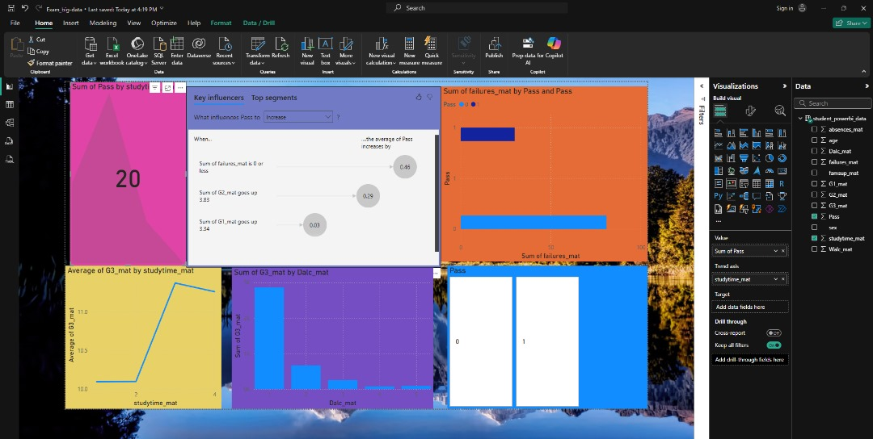
Power BI Dashboard
-I built a Power BI dashboard to make the data interactive. -Users can filter by gender, study time, or support. -It shows KPIs like average final grade and pass rate. -I also used AI visuals to highlight which factors most influence performance.

Slide 9
Insights & Results
Here are some of the key findings:
Repeated failures are the strongest indicator of failing again.
Weekday alcohol use is linked to lower grades.
Students with more study time and family support perform better. These insights can help schools target the right students for support.

Slide 10
Recommendations
Based on my results, I recommend:
Encouraging students to reduce alcohol use during the week
Promoting family support and mentorship programs
Monitoring students with past failures early in the term

